Slide 1
Enterprise Policy as Code (EPAC)
Azure Governance

Slide 2
Agenda
Approving Services and Compliance
Policy as Code deployments
Operational scripts
Demo

Slide 3
Approving Services and Compliance

Slide 4
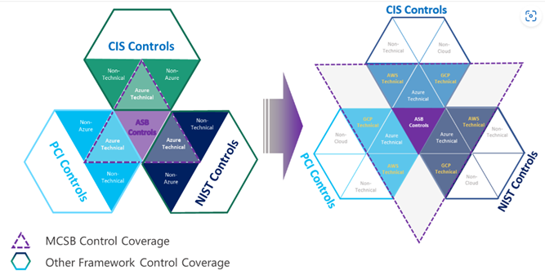
Compliance Policy Sets (Initiatives)
Azure Security Benchmark v57.2.0 based on Microsoft cloud security benchmark (v1)
This is the main compliance initiative MCSB v1
Mapped to:
CIS Controls v8 and v7.1
PCI-DSS v3.2.1
NIST SP 800-53 r4 (latest from NIST is r5)
Multi-Cloud

Slide 5
Recommendations for Compliance Policy Sets
Azure Security Benchmark
NIST 800-171 or 800-53 (adds important Policies)
Custom Policy set for gaps in built-in Policies
Should few Policies (< 30)
Do not use additional Initiatives
Instead use external mappings through tables
Assigning large number of additional compliance Initiatives
Complex deployments
Granting Exemptions can be excruciatingly painful

Slide 6
Mapping Controls and approving Azure services
Mapping must be per Azure service
Some controls do not apply based on Service characteristics
Some controls are immutably implemented
Some controls must be done with attestation instead of Policy
Mappings should be external to Azure
Mapping data structure in Azure is not ideal for adding additional mapped controls
Easy to determine if control implemented
Difficult to find gaps

Slide 8
Policy as Code

Slide 9
Efficiently managing Policies at scale
Policy definitions
Initiative definitions
Policy assignments
Policy exemptions
Simple DevOps flow based on GitHub flow
Feature branches
Pull requests
Prod stage approvals based on defined plan
No super-human knowledge needed
Any CI/CD tool Azure DevOps, GitHub, GitLab, Jenkins, …
Multi-Tenant 1-n , seen 2-4 tenants often – one org has 50 tenants
Define desired state
Assignments without copy/paste
Any scenario
Shared responsibility
Approvals
Excel for effect settings instead of JSON
Least privilege based
Excel for managing Exemptions instead of JSON

Slide 10
Enterprise Policy as Code and GitHub flow CI/CD
Development work in feature branch
Develop against EPAC dev environment (do not confuse with solution dev)
Commit triggers CI build and deployment to EPAC dev environment
CI build also calculates plan(s) for EPAC prod environments (everything but EPAC dev)
Pull request changes into main branch
Approver(s) must review code and review EPAC prod environment plan(s)
No extra build before merge (very expensive)
Pull request merge CD build (main branch)
CI build also calculates plan(s) for EPAC prod environments
Policy deployment stage approver(s) must review code changes and CD build plan(s)
Role deployment stage approver(s) must review role assignment plan(s)

Slide 11
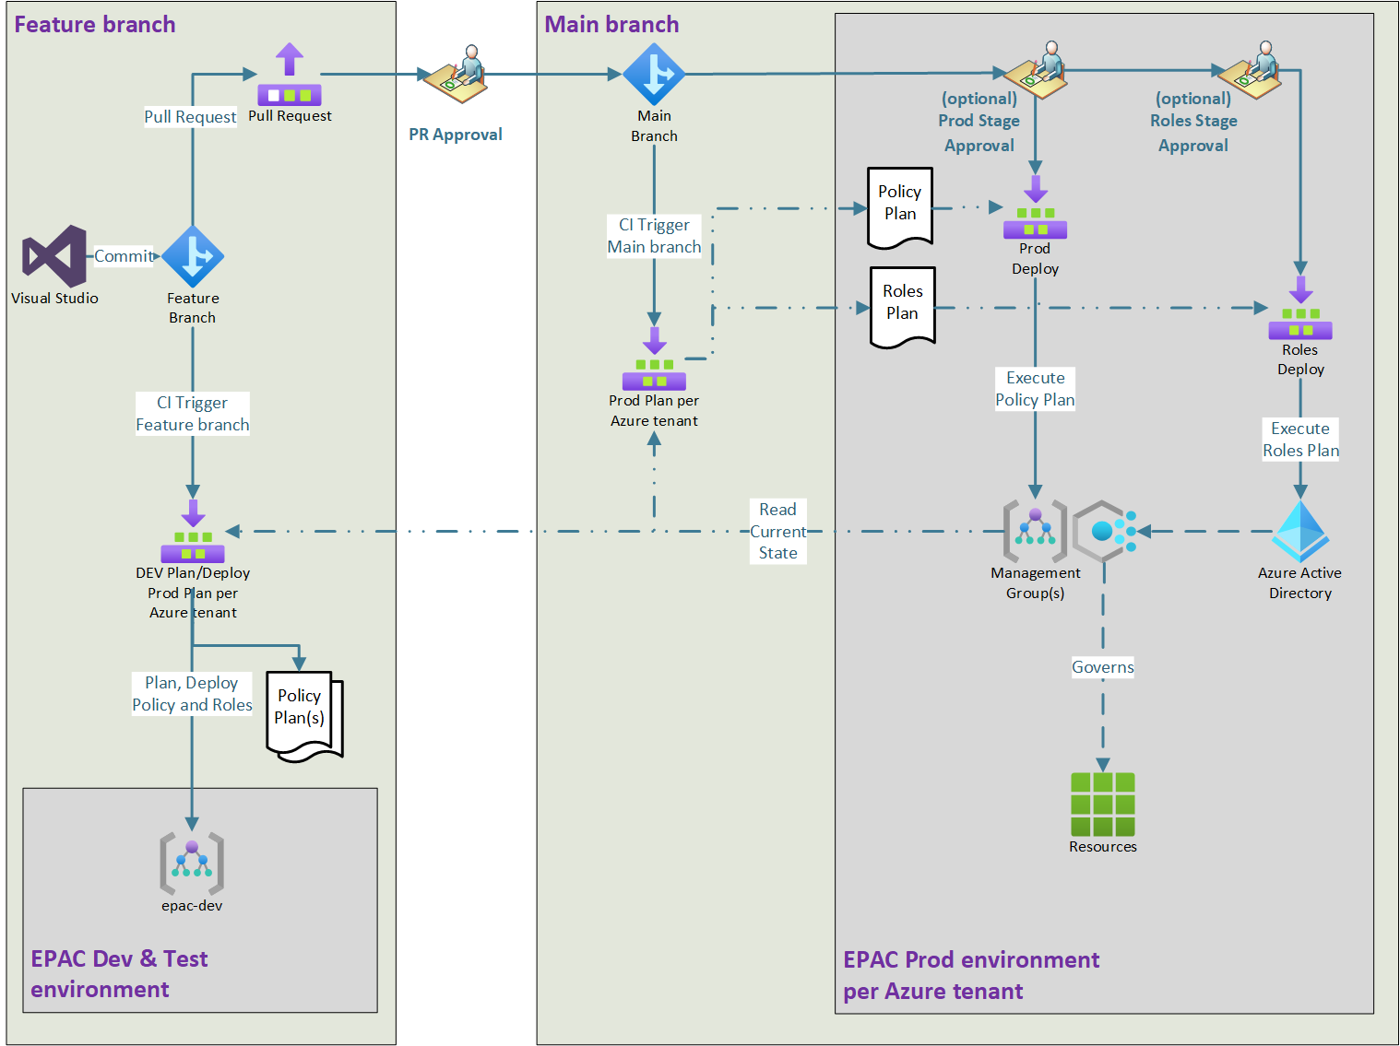
DevOps – Git and CI/CD

Slide 12
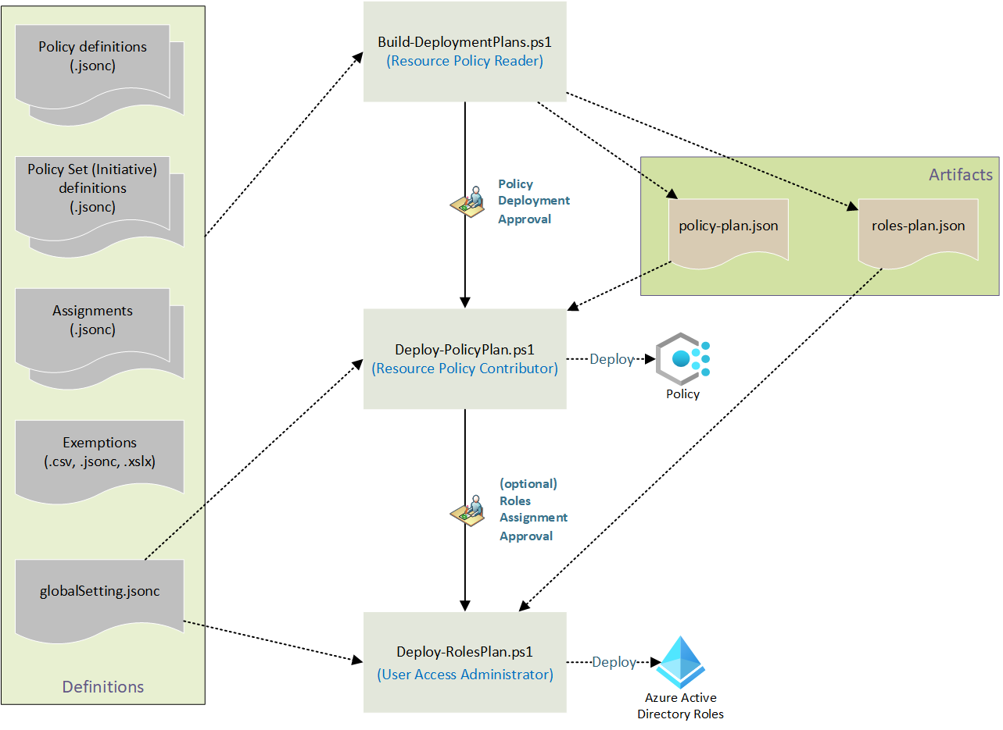
Deployment scripts

Slide 13
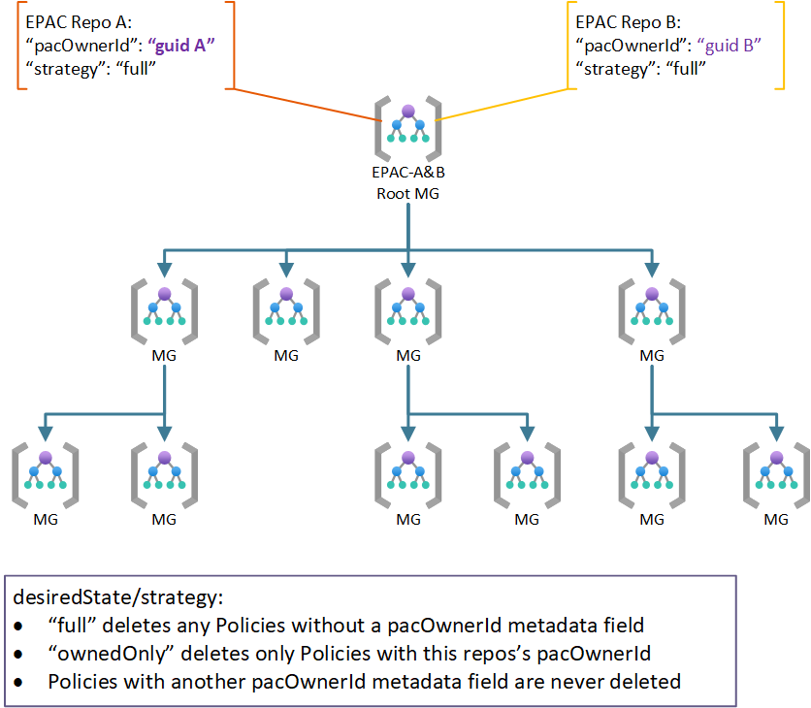
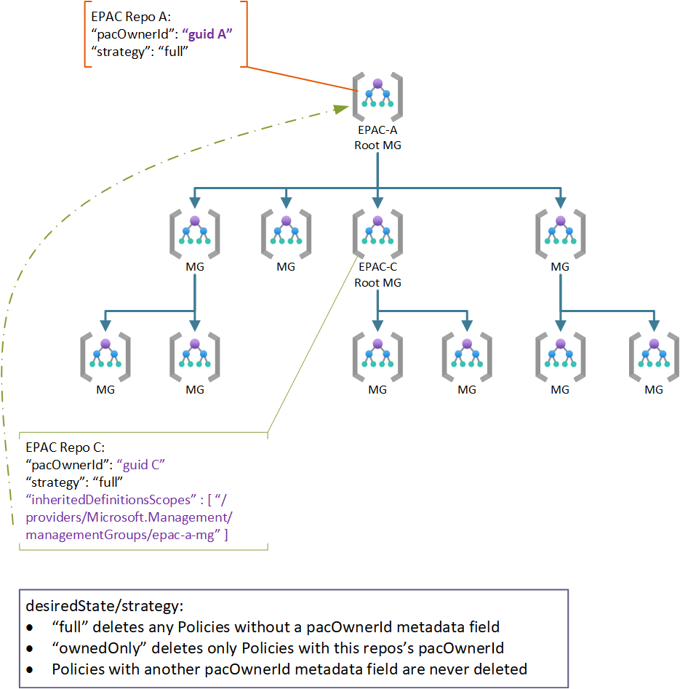
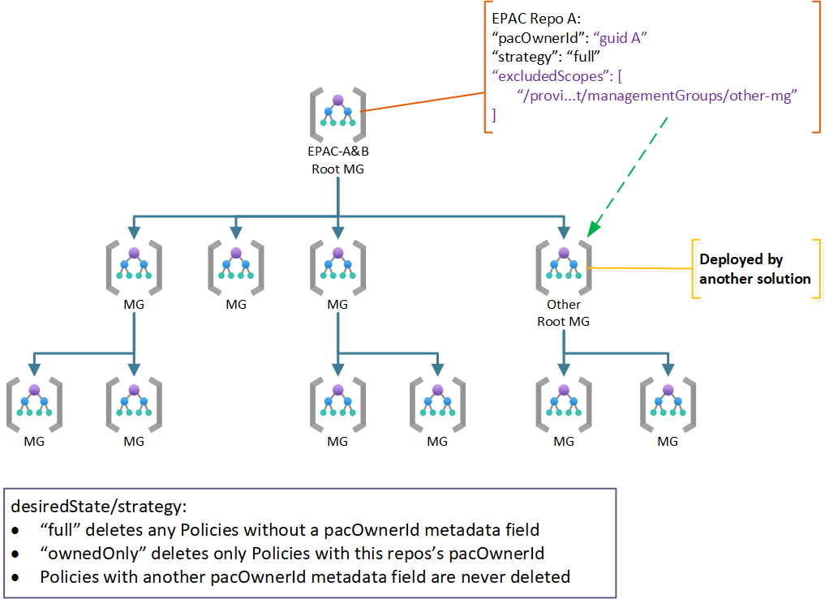
Transition to EPAC and/or multiple teams
Horizontal
Hierarchical
Excluding non-EPAC

Slide 14
Demo

Slide 15
Operational Scripts
Extract Policy resources from an existing environment
Document deployed Policy resources in Markdown and CSV
Create DeployIfNotExists and Modify remediation tasks in bulk
More
Operating

Slide 16
Questions

Slide 17
Links
Enterprise Azure Policy as Code (EPAC) – https://aka.ms/epac
EPAC Issues – https://github.com/Azure/enterprise-azure-policy-as-code/issues
Blog posts:
https://techcommunity.microsoft.com/t5/core-infrastructure-and-security/azure-enterprise-policy-as-code-a-new-approach/ba-p/3607843
https://techcommunity.microsoft.com/t5/core-infrastructure-and-security/azure-enterprise-policy-as-code-azure-landing-zones-integration/ba-p/3642784
https://techcommunity.microsoft.com/t5/core-infrastructure-and-security/azure-policy-recommended-practices/ba-p/3798024

Slide 18
Enterprise Policy as Code

